Slide 1

Customer Shopping Behavior Analysis
This project analyzes customer shopping behavior using transactional data from 3,900 purchases. Our goal is to uncover insights into spending patterns, customer segments, product preferences, and subscription behavior to guide strategic business decisions.

Slide 2

Project Overview
Data-Driven Insights
Strategic Decisions
Analyzing 3,900 purchases to understand customer spending and product preferences.
Guiding business strategies through insights into customer segments and subscription behavior.
Comprehensive Analysis
Covering demographics, purchase details, and shopping behavior metrics.

Slide 3

Dataset Summary
Data Volume
3,900 rows and 18 columns of transactional data.
Key Features
Demographics, purchase details, and shopping behavior (e.g., discount use, previous purchases).
Missing Data
37 values in the 'Review Rating' column.

Slide 4
Exploratory Data Analysis (EDA) with Python
01
02
03
Data Loading & Initial Exploration
Missing Data Handling
Column Standardization
Imputed missing 'Review Rating' values using median per category.
Renamed columns to snake_case for readability.
Imported dataset with pandas; checked structure and summary statistics.
04
05
Feature Engineering
Database Integration
Created 'age_group' and 'purchase_frequency_days' columns.
Loaded cleaned data into PostgreSQL for SQL analysis.

Slide 5

Data Analysis with SQL: Key Business Insights
1
2
Revenue by Gender
High-Spending Discount Users
Male customers generated significantly more revenue ($157,890) than female customers ($75,191).
Identified 839 customers who used discounts but still spent above average.
3
4
Top 5 Products by Rating
Shipping Type Comparison
Gloves (3.86), Sandals (3.84), Boots (3.82), Hat (3.80), Skirt (3.78) are top-rated.
Express shipping users had a slightly higher average purchase amount ($60.48) than Standard ($58.46).

Slide 6


SQL Insights: Subscriptions & Discounts
Subscribers vs. Non-Subscribers
Subscribers (1053) have an average spend of $59.49, non-subscribers (2847) average $59.87.
Discount-Dependent Products
Hat (50%), Sneakers (49.66%), Coat (49.07%), Sweater (48.17%), Pants (47.37%) are most discounted.

Slide 7




Customer Segmentation & Repeat Buyers
Loyal Customers
New Customers
3,116 customers classified as loyal.
83 customers identified as new.
Repeat Buyers & Subscriptions
Returning Customers
958 repeat buyers are subscribers, 2518 are not.
701 customers are returning.

Slide 8
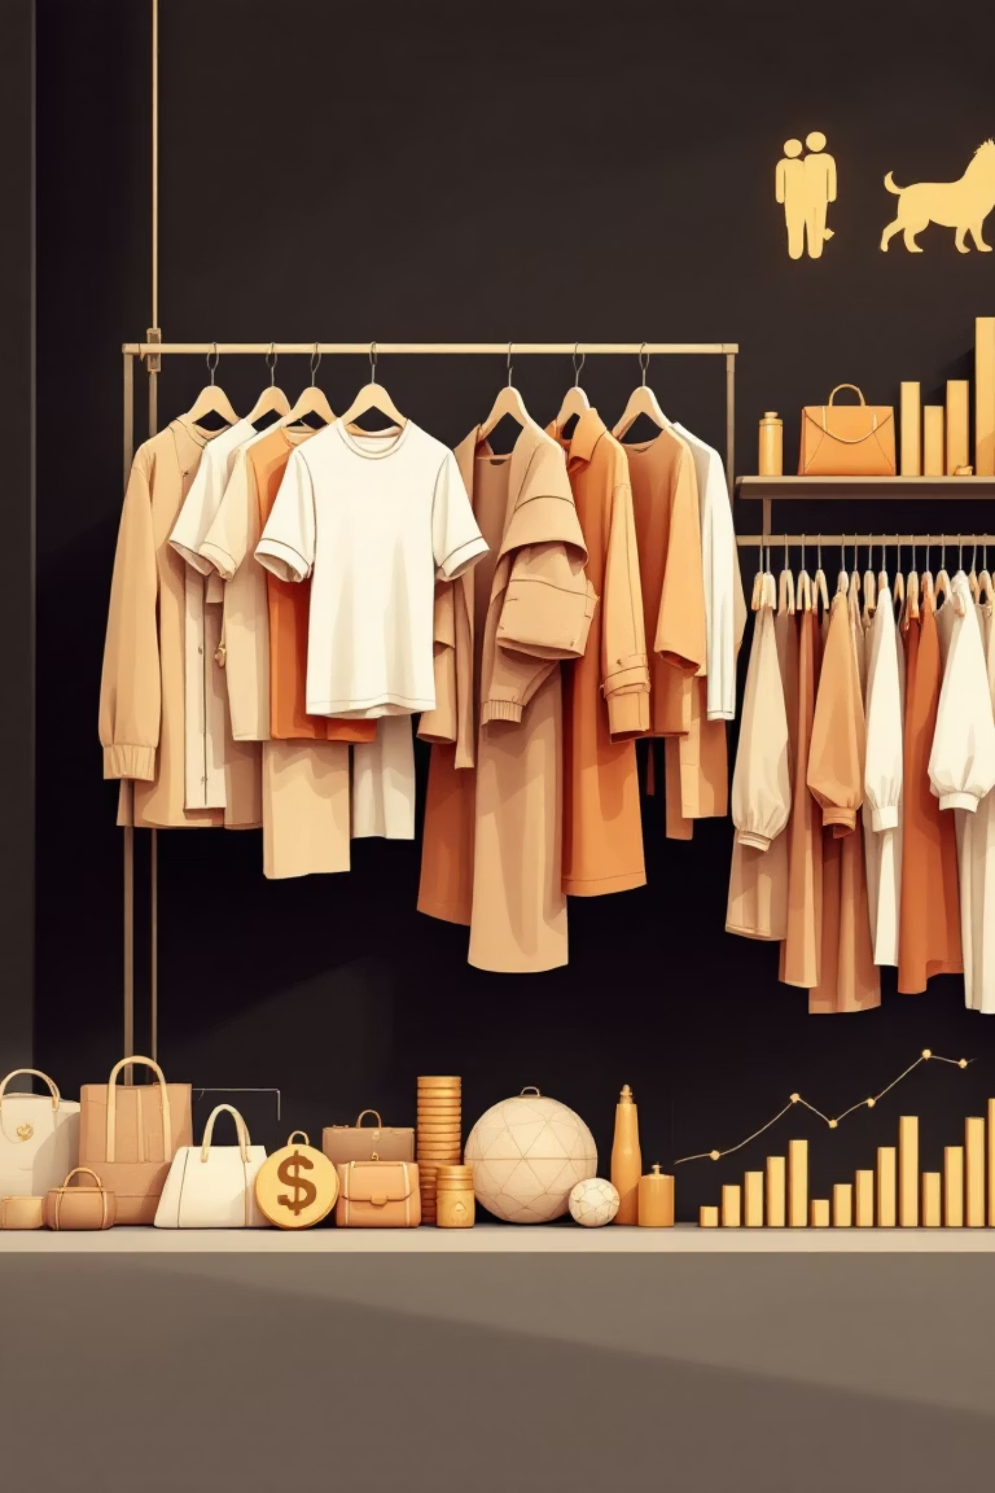
Top Products by Category & Age Group Revenue
Top 3 Products per Category
Revenue by Age Group
Accessories: Jewelry, Sunglasses, Belt
Young Adult: $62,143
Middle-aged: $59,197
Clothing: Blouse, Pants, Shirt
Adult: $55,978
Footwear: Sandals, Shoes, Sneakers
Senior: $55,763
Outerwear: Jacket, Coat

Slide 9
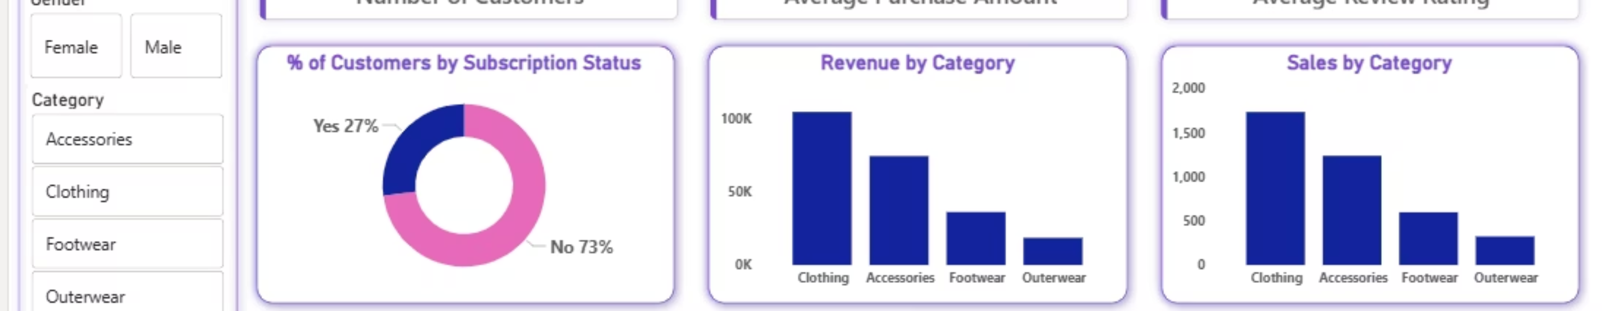
Interactive Dashboard in Power BI
An interactive dashboard was built in Power BI to visually present key insights from the customer shopping behavior analysis.
3.9K
$59.76
3.75
Customers
Avg. Purchase
Avg. Review

Slide 10





Business Recommendations
Boost Subscriptions
Promote exclusive benefits for subscribers to increase sign-ups.
Customer Loyalty Programs
Reward repeat buyers to foster loyalty and move them into the “Loyal” segment.
Review Discount Policy
Strategically balance sales boosts with margin control when applying discounts.
Targeted Marketing
Focus efforts on high-revenue age groups and express-shipping users for maximum impact.

